Slide 1
Computer Organization and Assembly Language Programming
Lecture-2

Slide 2
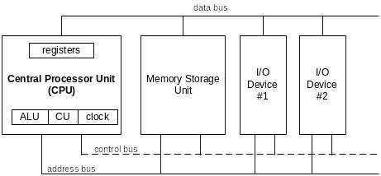
Basic Microcomputer Design
clock synchronizes CPU operations
control unit (CU) coordinates sequence of execution steps
ALU performs arithmetic and bitwise processing

Slide 3
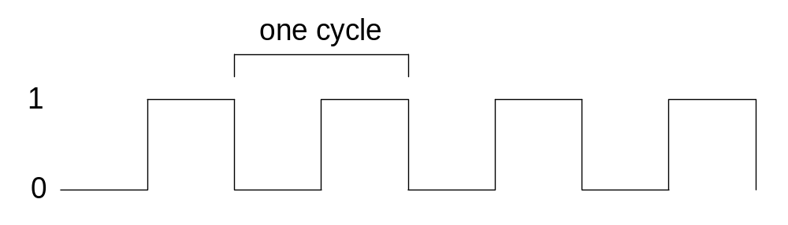

Clock
synchronizes all CPU and BUS operations
machine (clock) cycle measures time of a single operation
clock is used to trigger events

Slide 4
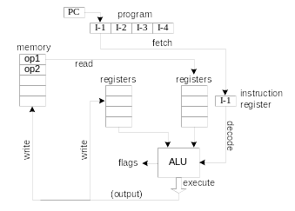

Instruction Execution Cycle
Fetch
Decode
Fetch operands
Execute
Store output

Slide 5
Multi-Stage Pipeline
Pipelining makes it possible for processor to execute instructions in parallel
Instruction execution divided into discrete stages
Example of a non-pipelined processor. Many wasted cycles.

Slide 6
Pipelined Execution
More efficient use of cycles, greater throughput of instructions:
For k states and n instructions, the number of required cycles is:
k + (n – 1)

Slide 7
Wasted Cycles (pipelined)
When one of the stages requires two or more clock cycles, clock cycles are again wasted.
For k states and n instructions, the number of required cycles is:
k + (2n – 1)

Slide 8
Superscalar
A superscalar processor has multiple execution pipelines. In the following, note that Stage S4 has left and right pipelines (u and v).
For k states and n instructions, the number of required cycles is:
k + n

Slide 9
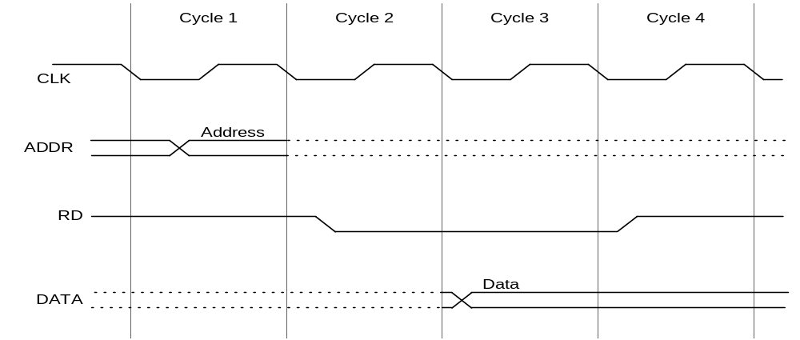
Reading from Memory
Multiple machine cycles are required when reading from memory, because it responds much more slowly than the CPU. The steps are:
  address placed on address bus
  Read Line (RD) set low
  CPU waits one cycle for memory to respond
  Read Line (RD) goes to 1, indicating that the data is on the data bus

Slide 10
Cache Memory
High-speed expensive static RAM both inside and outside the CPU.
  Level-1 cache: inside the CPU
  Level-2 cache: outside the CPU
Cache hit: when data to be read is already in cache memory
Cache miss: when data to be read is not in cache memory.

Slide 11
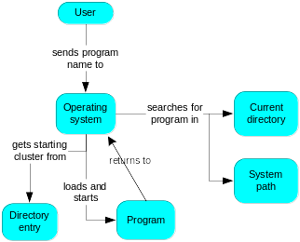
How a Program Runs

Slide 12
Multitasking
OS can run multiple programs at the same time.
Multiple threads of execution within the same program.
Scheduler utility assigns a given amount of CPU time to each running program.
Rapid switching of tasks
  gives illusion that all programs are running at once
  the processor must support task switching.

Slide 13
IA-32 Processor Architecture
Modes of operation
Basic execution environment
Floating-point unit
Intel Microprocessor history

Slide 14

Modes of Operation
Protected mode
  native mode (Windows, Linux)
Real-address mode
  native MS-DOS
System management mode
  power management, system security, diagnostics
Virtual-8086 mode
  hybrid of Protected
  each program has its own 8086 computer

Slide 15
Basic Execution Environment
Addressable memory
General-purpose registers
Index and base registers
Specialized register uses
Status flags
Floating-point, MMX, XMM registers

Slide 16
Addressable Memory
Protected mode
  4 GB
  32-bit address
Real-address and Virtual-8086 modes
  1 MB space
  20-bit address

Slide 17

General-Purpose Registers
Named storage locations inside the CPU, optimized for speed.

Slide 18


Accessing Parts of Registers
Use 8-bit name, 16-bit name, or 32-bit name
Applies to EAX, EBX, ECX, and EDX

Slide 19

Index and Base Registers
Some registers have only a 16-bit name for their lower half:

Slide 20
Some Specialized Register Uses (1 of 2)
General-Purpose
  EAX – accumulator
  ECX – loop counter
  ESP – stack pointer
  ESI, EDI – index registers
  EBP – extended frame pointer (stack)
Segment
  CS – code segment
  DS – data segment
  SS – stack segment
  ES, FS, GS - additional segments

Slide 21
Some Specialized Register Uses (2 of 2)
EIP – instruction pointer
EFLAGS
  status and control flags
  each flag is a single binary bit

Slide 22
Status Flags
Carry
  unsigned arithmetic out of range
Overflow
  signed arithmetic out of range
Sign
  result is negative
Zero
  result is zero
Auxiliary Carry
  carry from bit 3 to bit 4
Parity
  sum of 1 bits is an even number

Slide 23

Floating-Point, MMX, XMM Registers
Eight 80-bit floating-point data registers
  ST(0), ST(1), . . . , ST(7)
  arranged in a stack
  used for all floating-point arithmetic
Eight 64-bit MMX registers
Eight 128-bit XMM registers for single-instruction multiple-data (SIMD) operations

Slide 24
Intel Microprocessor History
Intel 8086, 80286
IA-32 processor family
P6 processor family
CISC and RISC

Slide 25
Early Intel Microprocessors
Intel 8080
  64K addressable RAM
  8-bit registers
  CP/M operating system
  S-100 BUS architecture
  8-inch floppy disks!
Intel 8086/8088
  IBM-PC Used 8088
  1 MB addressable RAM
  16-bit registers
  16-bit data bus (8-bit for 8088)
  separate floating-point unit (8087)

Slide 26
The IBM-AT
Intel 80286
  16 MB addressable RAM
  Protected memory
  several times faster than 8086
  introduced IDE bus architecture
  80287 floating point unit

Slide 27
Intel IA-32 Family
Intel386
  4 GB addressable RAM, 32-bit registers, paging (virtual memory)
Intel486
  instruction pipelining
Pentium
  superscalar, 32-bit address bus, 64-bit internal data path

Slide 28
Intel P6 Family
Pentium Pro
  advanced optimization techniques in microcode
Pentium II
  MMX (multimedia) instruction set
Pentium III
  SIMD (streaming extensions) instructions
Pentium 4
  NetBurst micro-architecture, tuned for multimedia

Slide 29
CISC and RISC
CISC – complex instruction set
  large instruction set
  high-level operations
  requires microcode interpreter
  examples: Intel 80x86 family
RISC – reduced instruction set
  simple, atomic instructions
  small instruction set
  directly executed by hardware
  examples:
    ARM (Advanced RISC Machines)
    DEC Alpha (now Compaq)

Slide 30
IA-32 Memory Management
Real-address mode
Calculating linear addresses
Protected mode
Multi-segment model
Paging

Slide 31
Real-Address mode
1 MB RAM maximum addressable
Application programs can access any area of memory
Single tasking
Supported by MS-DOS operating system

Slide 32

Segmented Memory
Segmented memory addressing: absolute (linear) address is a combination of a 16-bit segment value added to a 16-bit offset
one segment
linear addresses

Slide 33
Calculating Linear Addresses
Given a segment address, multiply it by 16 (add a hexadecimal zero), and add it to the offset
Example: convert 08F1:0100 to a linear address
Adjusted Segment value: 0 8 F 1 0
Add the offset: 0 1 0 0
Linear address: 0 9 0 1 0

Slide 34
Your turn . . .
What linear address corresponds to the segment/offset address 028F:0030?
028F0 + 0030 = 02920
Always use hexadecimal notation for addresses.

Slide 35
Your turn . . .
What segment addresses correspond to the linear address 28F30h?
Many different segment-offset addresses can produce the linear address 28F30h. For example:
28F0:0030, 28F3:0000, 28B0:0430, . . .

Slide 36
Protected Mode (1 of 2)
4 GB addressable RAM
  (00000000 to FFFFFFFFh)
Each program assigned a memory partition which is protected from other programs
Designed for multitasking
Supported by Linux & MS-Windows

Slide 37
Protected mode (2 of 2)
Segment descriptor tables
Program structure
  code, data, and stack areas
  CS, DS, SS segment descriptors
  global descriptor table (GDT)
MASM Programs use the Microsoft flat memory model

Slide 38
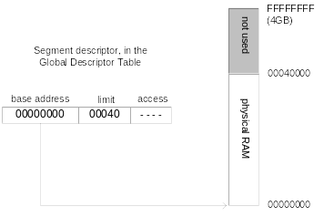
Flat Segment Model
Single global descriptor table (GDT).
All segments mapped to entire 32-bit address space

Slide 39
Multi-Segment Model
Each program has a local descriptor table (LDT)
  holds descriptor for each segment used by the program

Slide 40
Paging
Supported directly by the CPU
Divides each segment into 4096-byte blocks called pages
Sum of all programs can be larger than physical memory
Part of running program is in memory, part is on disk
Virtual memory manager (VMM) – OS utility that manages the loading and unloading of pages
Page fault – issued by CPU when a page must be loaded from disk

Slide 41
Components of an IA-32 Microcomputer
Motherboard
Video output
Memory
Input-output ports

Slide 42
Motherboard
CPU socket
External cache memory slots
Main memory slots
BIOS chips
Sound synthesizer chip (optional)
Video controller chip (optional)
IDE, parallel, serial, USB, video, keyboard, joystick, network, and mouse connectors
PCI bus connectors (expansion cards)

Slide 43
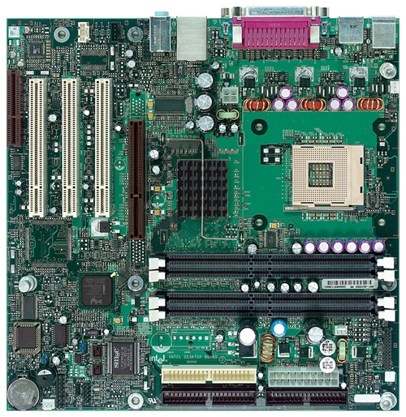
Intel D850MD Motherboard
Video
mouse, keyboard, parallel, serial, and USB connectors
Audio chip
PCI slots
memory controller hub
Pentium 4 socket
AGP slot
dynamic RAM
Firmware hub
I/O Controller
Speaker
Power connector
Battery
Diskette connector
IDE drive connectors

Slide 44
Video Output
Video controller
  on motherboard, or on expansion card
  AGP (accelerated graphics port technology)
Video memory (VRAM)
Video CRT Display
  uses raster scanning
  horizontal retrace
  vertical retrace
Direct digital LCD monitors
  no raster scanning required

Slide 45
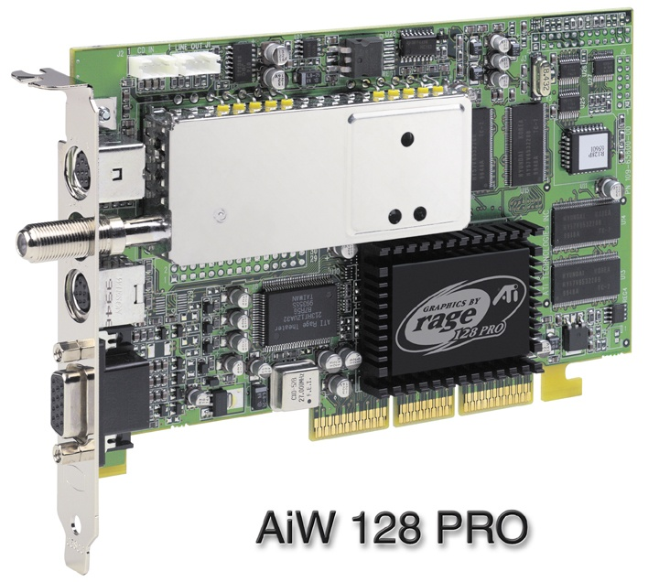
Sample Video Controller (ATI Corp.)
  128-bit 3D graphics performance powered by RAGE™ 128 PRO
  3D graphics performance
  Intelligent TV-Tuner with Digital VCR
  TV-ON-DEMAND™
  Interactive Program Guide
  Still image and MPEG-2 motion video capture
  Video editing
  Hardware DVD video playback
  Video output to TV or VCR

Slide 46
Memory
ROM
  read-only memory
EPROM
  erasable programmable read-only memory
Dynamic RAM (DRAM)
  inexpensive; must be refreshed constantly
Static RAM (SRAM)
  expensive; used for cache memory; no refresh required
Video RAM (VRAM)
  dual ported; optimized for constant video refresh
CMOS RAM
  complimentary metal-oxide semiconductor
  system setup information
See: Intel platform memory (Intel technology brief: link address may change)

Slide 47
Input-Output Ports
USB (universal serial bus)
  intelligent high-speed connection to devices
  up to 12 megabits/second
  USB hub connects multiple devices
  enumeration: computer queries devices
  supports hot connections
Parallel
  short cable, high speed
  common for printers
  bidirectional, parallel data transfer
  Intel 8255 controller chip

Slide 48
Input-Output Ports (cont)
Serial
  RS-232 serial port
  one bit at a time
  uses long cables and modems
  16550 UART (universal asynchronous receiver transmitter)
  programmable in assembly language

Slide 49
Levels of Input-Output
Level 3: Call a library function (C++, Java)
  easy to do; abstracted from hardware; details hidden
  slowest performance
Level 2: Call an operating system function
  specific to one OS; device-independent
  medium performance
Level 1: Call a BIOS (basic input-output system) function
  may produce different results on different systems
  knowledge of hardware required
  usually good performance
Level 0: Communicate directly with the hardware
  May not be allowed by some operating systems

Slide 50
Displaying a String of Characters
When a HLL program displays a string of characters, the following steps take place:

Slide 51
ASM Programming levels
ASM programs can perform input-output at each of the following levels:

Slide 52

42 69 6E 61 72 79

